Slide 1
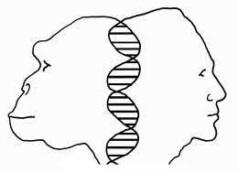
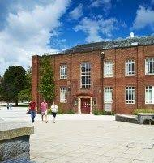
Masters by Research (MSc)
in
Evolutionary and Biological Anthropology
Offered by the Department of Anthropology
and the
Evolutionary Anthropology Research Group at Durham University, UK
We offer a one-year postgraduate programme aimed at developing your research skills and enhancing your CV and employability. The programme offers you training in research methods and the chance to undertake a potentially publishable research project in one of a range of fascinating topic areas.
This is an excellent platform for those wishing to go on to a PhD.

Slide 2
Evolutionary and Biological Anthropology @ Durham
Our research applies evolutionary theory to understanding human and non-human primate behaviour, biology, ecology, and diversity. We focus on three overlapping and complementary research areas: cognitive and cultural evolution; primatology; human and primate evolution, and we use experimental, observational, modelling and comparative methods. Many staff are active at field sites in Africa, Asia and elsewhere.
We are a world renowned location for research in biological anthropology. Staff members include former Presidents of the Cultural Evolution Society and Primate Society of Great Britain and past and current editors of journals such as Journal of Human Evolution and International Journal of Primatology. We house one of the best palaeoanthropology teaching collections in the UK, as well as a new endocrinology and ecology laboratory.
Research in evolutionary/biological anthropology is theoretically exciting and topical, enabling us to understand what it means to be human in our rapidly changing world, including why we behave as we do and how we interact with each other and other animals.
Our research has clear potential for societal benefit, for example in addressing our attraction to ‘fake news’, behaviour during pandemics, and animal conservation in an increasingly interconnected and anthropogenically influenced world.

Slide 3
Evolutionary and Biological Anthropology @ Durham
We welcome applications from students interested in the areas below, and some staff have outlined potential projects on the following pages. You are also encouraged to approach potential supervisors with your own project ideas!
Cultural evolution and social learning
Forensic anthropology and human/hominin morphology
Human behaviour and cognition
Palaeoanthropology and palaeoecology
Primate evolution, adaptation, behavioural ecology and cognition
Primate conservation and human-primate interactions
Also see info on Why do an MSc by research Why study @ Durham Application Process

Slide 4
Why do a 12 month Masters (MSc) by Research @ Durham?
Flexibility - October, January, or April start dates and possibility of part-time (UK only) and remote study.
Participation in a world-leading research group involving close collaboration with staff and other students.
Lower tuition fees than a taught Masters programme, yet many diverse training opportunities.
Autonomy in direction of studies and opportunity to demonstrate independence and innovation.
Develop and evidence transferable skills that are highly desired by employers
(e.g. collaboration, independence, innovation, project management and delivery, time management,
analysis, written and verbal presentation skills etc.).
Develop in-depth and specialised knowledge and skills while producing a substantial thesis.
Higher potential (than a taught Masters) of producing a publishable piece of work.
Determine whether a PhD is for you and acquire the skills/qualifications for academic success (an MSc is usually required to gain PhD funding and a publication makes you more competitive).

Slide 5
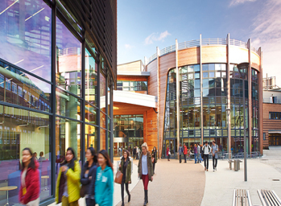
Why Study at Durham University (UK)?
The University (‘World Top 100’)
We are a ‘World Top 100’ University, demonstrating excellence in teaching, research and the student experience. The Durham Centre for Academic Development and Research Methods Centre offer supports for students in developing relevant skills.
The Anthropology Department (‘World Top 50’ & ‘UK Top 10’)
The Department is the largest in the UK and one of few globally that integrate evolutionary, social, and medical anthropology, thus providing a wide-ranging intellectual experience. We also host a student-led annual postgraduate conference and offer small research bursaries.
Staff in the Evolutionary Anthropology Research Group have links with colleagues in Psychology, Biosciences and Archaeology. We participate in additional research groups (e.g. Primatology Group; Durham Cultural Evolution Research Centre; Osteo Club) and can facilitate the use of various labs and research equipment, such as 3D scanners.
The Colleges
These provide a welcoming and caring residential and social environment, including accommodation, advice/support, and extra-curricular activities. We have a dedicated postgraduate college: Ustinov College.
Durham City
A beautiful UNESCO World Heritage Site and small city only 10 minutes by train from Newcastle (York 1hr, Edinburgh 2hrs, London 3hrs), and surrounded by National Parks (e.g. Lake District), historic castles, and stunning coastline.

Slide 6
The Application Process
Please informally discuss your own ideas and/or listed projects that you are interested in with the respective supervisors (find contact details by clicking their name). It is expected that you will likely discuss multiple projects with multiple supervisors to find the right one for you.
When you have decided on a project through discussion with a supervisor complete the formal application for postgraduate study in Anthropology at Durham University. If you are undertaking a project offered in the following pages, in your application you should refer to the project code which is listed after the title.
You will need:
A 2.1 or 1st Class Undergraduate Degree (or equivalent in your country).
Evidence of English language proficiency if you are a non-native English speaker (e.g. a recent degree from a majority English speaking country OR a Secure English Language Test (SELT), such as IELTS, scoring 7 or the equivalent).
Two academic references (you can apply without these in hand, but check that your referees are willing before naming them on your application).
Financial information:
You can find out about funding, postgraduate research tuition fees and living costs in Durham here.
Unfortunately, there is very little funding available for Masters programmes (though there is more for a PhD should you wish to continue postgraduate study)

Slide 7
Staff Specialisms in Evolutionary and Biological Anthropology
If you are interested in the following areas, see the pages for each staff member to learn more about the projects they could be offering, some of which are co-supervised with staff in other departments. Contact staff to discuss these or your own project ideas.
Cultural Evolution and Social Learning
Sally Street Rachel Kendal Amanda Tan Jeremy Kendal
Forensic Anthropology and Human/Hominin Morphology
Trudi Buck Sarah Elton Fire Kovarovic
Human Behaviour and Cognition
Sally Street Rachel Kendal Amanda Tan Jeremy Kendal Jo Setchell Rob Barton Russell Hill
Also see info on Why do an MSc by research Why study @ Durham Application Process

Slide 8
Staff Specialisms in Evolutionary and Biological Anthropology
If you are interested in the following areas, see the pages for each staff member to learn more about the projects they could be offering, some of which are co-supervised with staff in other departments. Contact staff to discuss these or your own project ideas.
Palaeoanthropology and Palaeoecology
Fire Kovarovic Sarah Elton Trudi Buck
Primate Evolution, Adaptation, Behavioural Ecology and Cognition
Jo Setchell Amanda Tan Sarah Elton Ann MacLarnon Russell Hill Rob Barton Rachel Kendal
Primate Conservation and Human – Primate Interactions
Russell Hill Amanda Tan Jo Setchell Ann MacLarnon Rachel Kendal Sarah Elton
Also see info on Why do an MSc by research Why study @ Durham Application Process

Slide 9
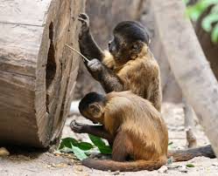
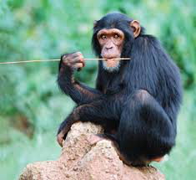
Rob Barton
Primate brain evolution: testing the Visuo-motor Brain Hypothesis [RB1]
Anthropoid primates have large brains and an array of adaptive specializations for high acuity stereo vision and visually guided manipulation (e.g. tool use). The idea that these characteristics are linked has received some support. The availability of comparative data on vision, visual anatomy and brain structure together with powerful new comparative methods of analysis make it possible to now definitively test this hypothesis. This is a desk- and library-based research project involving the assembly and statistical analysis if secondary data sources.
Species differences in manipulation: ontogeny and evolution [RB2]
Complex foraging styles involving tool use are hypothesised to be significant drivers of primate cognitive evolution. Little is known about how and when these capacities develop during ontogeny, but they are thought to involve neuro-developmental processes scaffolded by object manipulation. This project would study the propensity of juvenile primates in captivity, or semi-natural sanctuary settings, to approach and manipulate objects, testing the hypothesis that developmental species differences in object manipulation and curiosity are associated with reliance on tool use and extractive foraging in the wild. In the event that covid-related restrictions rule out collection of primary data, the project could focus on a pre-collected dataset with bonobos and/or the co-evolution of anatomical features of hand and brain that together support manipulative skills.
Co-Supervisor: Zanna Clay (Psychology)

Slide 10
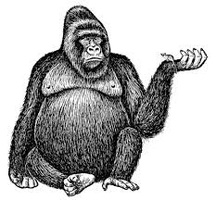
Rob Barton
Ecological correlates of body size in primates [RB3]
Body size is a fundamental aspect of a species adaptations, and varies approximately 2000-fold across the primate order. Surprisingly, however, the relationships between size, sexual dimorphism, behaviour and ecology in primates remain poorly understood. This project would compile comparative data on male and female body masses and behavioural ecology and use cutting-edge phylogenetic methods to re-examine hypotheses about how size, diet, substrate use, ranging behaviour, activity pattern and sociality are interrelated.
Co-Supervisor: Sarah Elton (Anthropology)

Slide 11
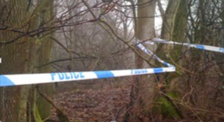
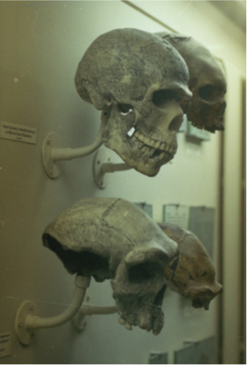
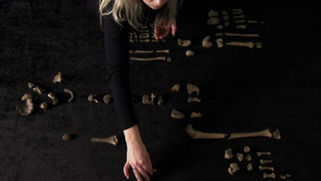
Trudi Buck
Forensic Anthropology, Human Morphology and Palaeoanthropology projects [TB1]
If you are interested in topics related to forensic anthropology, human skeletal morphology, or palaeoanthropology please contact Trudi Buck who is keen to supervise projects that explore areas including the following:
Theoretical and practical dimensions of forensic anthropology
The evolution of human skeletal morphology
Modern human craniofacial variation
Ontological approaches to biological anthropology
Bioarchaeology
Osteobiography
Public engagement with science and anthropology

Slide 12
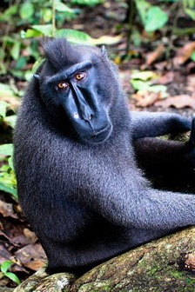
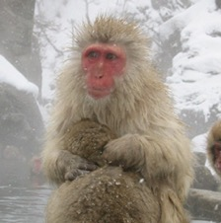
Sarah Elton
Environmental influences on facial diversity in macaques [SE1]
Numerous studies have explored the link between environment and facial morphology in modern humans and Neanderthals, with some studies suggesting that the mid face adapts in response to relative temperature and humidity. Similar adaptation may be expected in other primates, but very little is known about environmental influences on their faces. The macaques, with their distribution across a wide area of Asia, covering tropical and temperate zones, are an ideal group in which to study this.
In this project you will use an existing large geometric morphometric dataset to compare facial morphologies in different macaque species. You will investigate the relationship between morphology and different climatic variables to assess whether facial differences occur in species living in moist, warm compared to cold, dry environments. Your results will contribute to our understanding of diversity and adaptation in primates, including modern humans and Neanderthals.

Slide 13
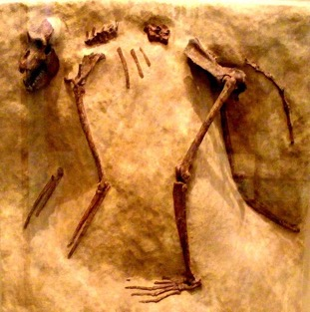
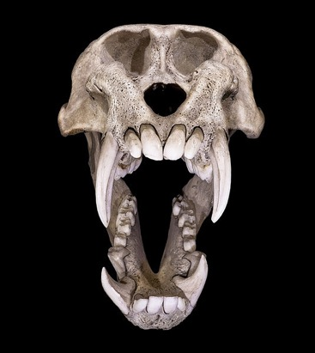
Sarah Elton
Ancestral body masses in African monkeys [SE2]
Some African fossil monkeys were huge, reaching the sizes seen in modern gorillas. Others that did not get so large were still much bigger than their closest living relatives. But does that mean that their ancestors were also very big? And why did such large size evolve? In this project, you will collate a database of fossil and modern monkey body masses and other traits, build evolutionary trees that include extant and extinct species, and use Bayesian analysis to investigate Old World monkey evolution. Your results will help to explain why some Pleistocene monkeys reached such large sizes, and why they went extinct. Your work will thus assist in elucidating the evolutionary history of a fascinating group of animals, which originated at a similar time to the hominins and lived alongside them.
Cranial diversity in Old World monkeys: adaptive versus neutral processes [SE3]
Cranial diversity in Old World monkeys can be explained in part by adaptations to diet and environment. But even when those are taken into consideration, a great deal of variation goes unexplained. Some of this is probably due to neutral evolutionary processes, such as genetic drift, but very few studies have explored this in non-human primates. In this project, you will use a large geometric morphometric dataset, focusing on the relative contributions of drift and selection. Your results will provide vital information about how diversity arises in monkeys and thus provide important background data for primate conservation efforts.

Slide 14
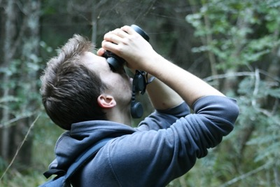
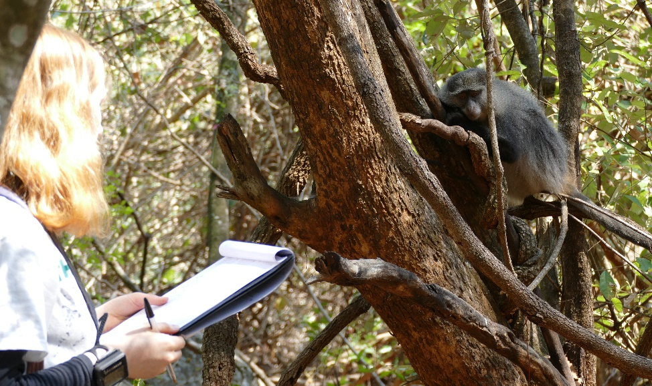
Russell Hill
Vigilance in humans [RH1]
Vigilance functions to detect threats and understanding the social and ecological drivers of vigilance behaviour has been a popular topic of study in a range of taxa, including primates. Interestingly, comparatively few studies have explored vigilance in humans, despite humans offering the opportunity to explore the topic in a number of distinctive ways.
Red and dominance in humans: is there an optimal red? [RH2]
Studies have shown wearing red increases the probability of winning sporting contests and that red-wearers are more often categorized as ‘angry’ and perceived as more ‘dominant’ and more ‘aggressive’ than targets wearing blue or grey. This project will assess whether there is an ‘optimal red’ for creating these dominance associations.
Co-Supervisor: Rob Barton (Anthropology)
Human observers and primate mixed-species associations [RH3]
Behavioural studies on primates traditionally habituate groups to the presence of human observers. However, evidence increasingly suggests that observers never become ‘neutral’ within a primate group and instead impact predator-prey interactions, social networks and many aspects of behaviour in ways that change with time. This project will use long-term data on samango monkeys from the Primate & Predator Project in South Africa to explore how observers impact polyspecific associations and other behaviour over time.

Slide 15
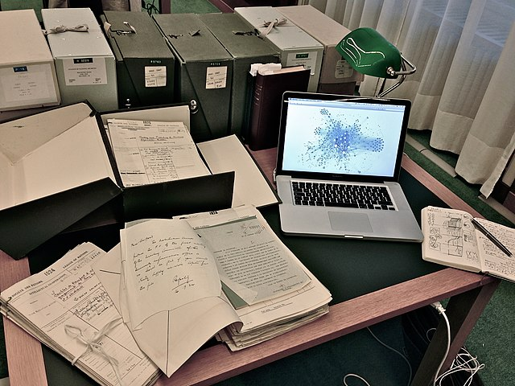
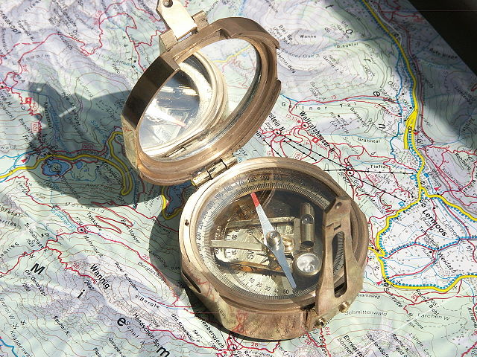
Jeremy Kendal
Investigating the Practice of Research Methods [JK1]
Focusing on the day-to-day practice of social science research methods, avenues for investigation include: the transmission of practice across academic generations; changing relationships with research methods practice over an academic life; how practice relates to understandings of research methods; variation in training environments and normative practice across disciplines. This project would be excellent for anyone with a keen interest in social science research methods and epistemology. The student has the opportunity to work with the Durham Research Methods Centre. The project can be a stepping stone for a student interested in developing research methods training and shaping research environments.
Culturally Evolving Memories [JK2]
Following the cross-disciplinary Representing Memory project at the Institute of Advanced Study, Durham, this project examines how memories are formed and socially transmitted in real-world contexts. Using real-world navigation tasks, the research takes an interdisciplinary perspective to examine how properties of spatial and episodic memories culturally evolve.
Co-Supervisor: Alex Easton (Psychology).

Slide 16
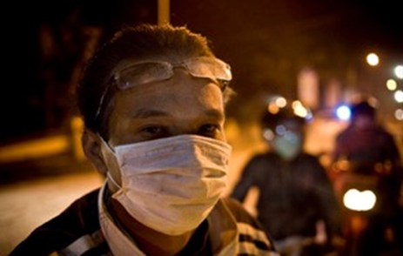
Rachel Kendal
Applying knowledge of cultural transmission biases in designing effective public health products [RK1]
You would work with data already collected as part of the HIVE (Health Interventions in Volcanic Eruptions) project, including (i) a workshop to co-design outreach products (posters, leaflets, informational videos) with NGOs, Government Ministries and community members in Jogyakarta (Indonesia) about protecting yourself from breathing volcanic ash and fitting facemasks. (ii) questionnaires and videos of mask donning collected to evaluate the effectiveness of the products for local communities. You may also
revisit the communities to conduct an evaluation of longer-term effectiveness of the products. Alternatively, you may pursue an additional study inspired by your research or guided by a new venture (FACE-UP) your supervisors are making into public health messaging regarding air pollution.
Co-Supervisor: Claire Horwell (Earth Sciences)
Tool innovation in children [RK2]
You will experimentally examine the development of tool innovation by presenting a range of tasks to children. Data will be collected either in person (at a local Science Centre and/or in schools) or online.
Co-Supervisor: Bruce Rawlings, Sheina Lew-Levy (Psychology)

Slide 17
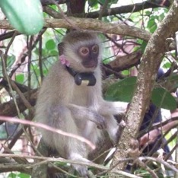
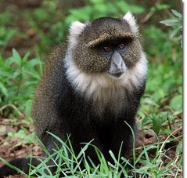
Rachel Kendal
Rehabilitated-released monkeys and comparator wild groups in Kenya’s Coral Rag Forest – Vervets [RK3]
Using 2 years of social network data for 3 groups of vervet monkeys (1 rehabilitated-released, 2 natural) living in human modified habitat. Questions include comparing group cohesion and the characteristics of central individuals across groups. Students may also propose additional questions of interest.
Rehabilitated-released monkeys and comparator wild groups in Kenya’s Coral Rag Forest – Sykes Monkeys [RK4]
As above but with 3 groups of sykes monkeys. Here, 4 released individuals integrated into a wild group so the questions may be slightly different.
Wildlife interactions in Kenya’s Coral Rag Forest [RK5]
Exploring wildlife interactions and sleeping site use of all vervet and sykes groups in the human modified habitat of Diani Beach.
Co-supervisors: Russell Hill, Andrea Donaldson (Anthropology)

Slide 18
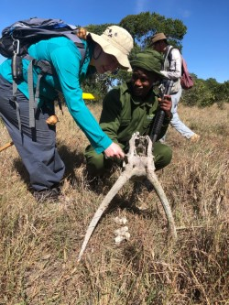
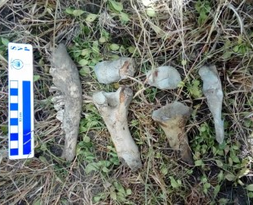
Kris “Fire” Kovarovic
Palaeoanthropology and Palaeoecology [FK1]
If you are interested in any aspect of mammalian palaeoecology, particularly as it relates to understanding the ecology and palaeoenvironments of Pliocene and Pleistocene hominins in Africa and Asia, please contact Dr Kovarovic.
I prefer to develop projects in collaboration with students, rather than offering ready-made projects from the outset. Your interests are the best place to start the discussion! Contact me so we can explore the possibilities. Note that projects could involve fieldwork or museum-based data collection, but this is not strictly necessary as there may be plenty of secondary data available in the literature or from my collaborators.
Here are some ideas to get you thinking:
2D and 3D assessments of mammalian skeletal and dental morphologies (particularly, but not limited to, ungulate species) as these relate to their habitat adaptations such as locomotion and dietary behaviours
How knowledge of these mammalian adaptations can be used to reconstruct ancient habitats (i.e. ecomorphology)
Mammal community analyses of modern faunas or palaeofaunas from anywhere in the world
Other related topics are also possible, including taphonomy and developing approaches to accounting for taphonomic biases in certain ecological settings.

Slide 19
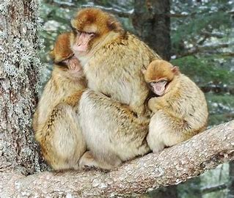
Ann MacLarnon
Physiology and Behaviour in Primates [AM1]
If you are interested in the physiology and behaviour of primates, particularly in relation to human-primate interactions (e.g. tourism, provisioning, captivity), contact Ann MacLarnon to discuss potential projects in topics such as:
Ecological physiology
Non-invasive measurement of hormones
Behavioural endocrinology
Adaptation and stress
Sociality and stress

Slide 20
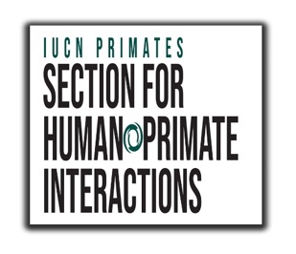
Jo Setchell
How do images influence people’s perceptions of primates? [JS1]
Investigate how people engage with images of primates and how that influences their perceptions of primates and their conservation status.
This project would be in partnership with the IUCN Primate Specialist Group Section for Human-Primate Interactions.
Evolutionary ecology of mandrills [JS2]
Jo Setchell is a world expert on the behavioural ecology and reproductive strategies of mandrills. This would involve fieldwork in Gabon for behavioural data collection. To discuss projects that build on her work, please get in touch with Jo.

Slide 21
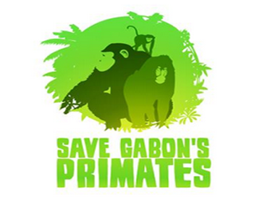
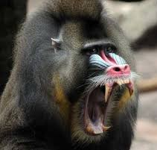
Jo Setchell
Primate conservation, decolonising primatology and ethically-engaged approaches to primatology [JS3]
If you are interested in these areas, please look at Prof. Jo Setchell’s webpage then contact her to discuss potential projects not listed here.
Primate evolutionary ecology [JS4]
If you are interested in this area, please look at Prof. Jo Setchell’s webpage then contact her to discuss potential projects not listed here.

Slide 22
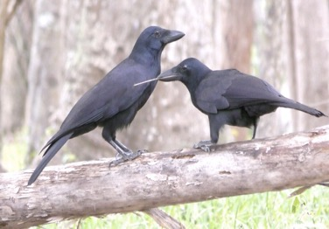
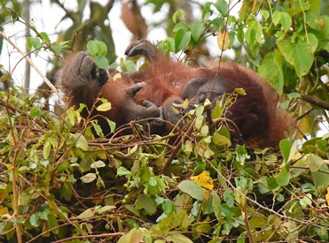
Sally Street
Societal stereotypes and perceptions of animal behaviour [SS1]
The extent to which societal stereotypes affect the perception of animal behaviour among the scientists who study them remains a controversial question.
In this project you would use interviews, surveys and/or experiments to investigate if and how societal biases affect the perception of ‘charismatic’ animal behaviours among both experts and non-experts. A particular question may be the role that gender stereotypes about ‘technical intelligence’ may play in the perception of tool use and nest-building in mammals and birds.
Evolution of animal construction [SS2]
Why some animal species have evolved to build ‘artefacts’, including nests, burrows and bowers, in such a dazzling array of different forms largely remains to be explained. The ability to construct habitats to suit our needs has played a fundamental role in the evolution of our own species, and has been instrumental in allowing us to inhabit such a wide range of environments.
You would use phylogenetic comparative analyses to investigate possible evolutionary causes and consequences of animal construction in mammals and birds, which may shed light on the role construction has played in human evolution.

Slide 23
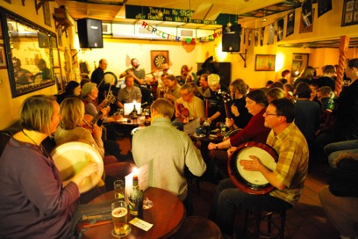
Sally Street
Cultural evolution of traditional folk music [SS3]
The origins and diversification of traditional folk music remain under-investigated from a cultural evolutionary point of view. Traditional folk music, however, presents an ideal test case for investigating the way that common cognitive biases may shape how folk melodies change over time.
You would use experiments, phylogenetic analysis and/or secondary data analysis to test fundamental cultural evolutionary predictions applied to traditional folk music.

Slide 24
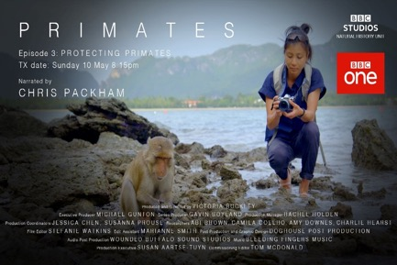
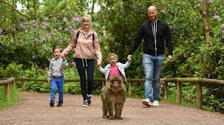
Amanda Tan
Cognitive biases in documenting primates [AT1]
Cultural transmission research has demonstrated that humans are predisposed to receiving, retaining, and transmitting some types of information over others. Consequently, the extent to which information spreads and persists is often influenced by biases in human cognition rather than by the accuracy or adaptive relevance of informational content (think conspiracy theories and ‘fake news’).
You would examine the impact of cultural transmission biases on the representation and depiction of primates in wildlife documentaries, and how the genre has evolved, identifying implications for conservation and education.
Applying social network and personality trait analyses to understanding human-primate interactions [AT2]
Social networks in group-living primates influence the acquisition and transmission of a wide range of behaviour. There is also growing recognition that individual variation in personality traits further influence social networks and behavioural transmission. In this project, you will examine how macaque social networks and individual-specific traits modulate how free-ranging macaques interact with visitors in a wildlife park. Results may provide insights for understanding and promoting human-primate coexistence in areas of sympatry.
Credit: Trentham Monkey Forest

